Slide 1
It is about the evidence, not the events: Historiographic Explanation
Aviezer Tucker
CEVRO University, Prague, Czech Republic
avitucker@yahoo.com

Slide 2
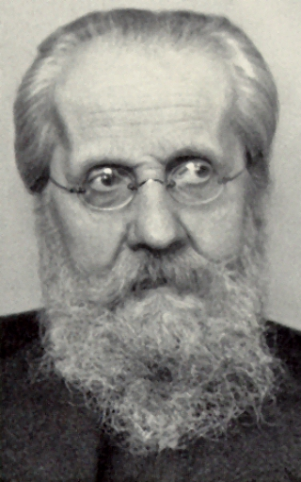
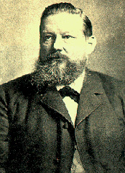
A philosophical problem with long beards

Slide 3
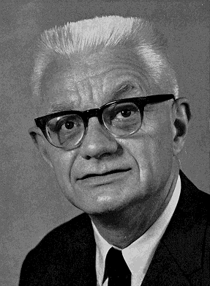
Neo-Kantian shaved
Deductive structure of Explanation:
Minor Premise: History (previously ideographic)
Major Premise: Nomothetic, from the Social Science
Historiography as Applied Social Science

Slide 4
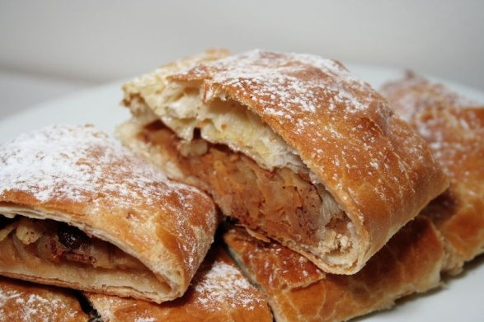
Shortcomings of Logical Positivism
Classical counter arguments:
Uniqueness and complexity of events.
New Counter Arguments:
No historical observation sentences: Against the Strudel theory of historiography.
All Historiography is information theory laden

Slide 5
Tokens vs. Types
As particulars, tokens necessarily occupy a unique spatial-temporal location.
Types as abstracts do not.
Revolution is a Type, the French Revolution is a token.

Slide 6
Sciences of tokens and types
Historiography and the historical sciences infers common cause token events from token evidence with information theories.
The Social Sciences and the theoretical sciences infer common cause types of events from types of evidence with statistical theories.

Slide 7
Information
Some processes tend to preserve in their end states information from their initial state more than others. Processes have varying levels of fidelity, reliability or credibility.
The selection of historical evidence according to its information preserving qualities is theory laden and is bootstrapped by historiographic knowledge of the chains that transmit information in time.

Slide 8
I: Comparison of Likelihoods
The first stage of inference compares the likelihood that the correlations between evidential units preserve information about some common cause they all share whose properties are not specified with the likelihood that the correlations result from separate causes whose properties are specified:
Pr(evidence| some common cause) Pr(common cause)
-----------------------------------------
Pr(evidence| no common cause)Pr(no common cause)

Slide 9
Priors
In assessing the priors of the common cause and separate causes hypotheses, historians examine:
Whether causal chains that extend backwards from the units of the evidence could or could not have intersected and converged.
The coherence of the hypotheses with existing nets of historiographic beliefs.

Slide 10
Likelihoods
The likelihood of the evidence given separate causes reflects the functions of the shared properties of the evidence. Sometimes, of the same type of function and cause.
Evidence whose shared information preserving properties have no conceivable functional value, or even confer a disadvantage on their bearers, usually radically decrease the likelihood of the evidence given separate causes.
E.g. homologies vs. homoplasies

Slide 11
Multiple units of evidence
When the likelihood of each unit of evidence given separate causes is low, the effect of multiple members, such as similar testimonies, is to decrease exponentially this likelihood.

Slide 12
Stage II: Identifying Information Transmission Nets
Y: A single ancestral common cause.
W: Several ancestral common causes:
K: A single common cause may be a member of the set of species.
H: Hybridity
A: Combinations of Y or W, with K or H.

Slide 13
Independence
If the structure of the information transmitting net is exclusively “V” or “W” shaped, the units of evidence are independent. Independence of evidence is the absence of intersection between the causal-information chains that connect the units of evidence with their common cause or causes.

Slide 14
Dependence is not Decadence
If the evidence is not independent, the historian needs to distinguish the properties of the evidence that preserve information about an original common cause or causes from those that preserve information about later stages in information transmission between the units of evidence. This is not always possible:
The Indo-European languages vs. The Bible.

Slide 15
III: Inference of Concrete Common Cause
The prior probabilities of a specific common cause hypothesis, C₁, C₂,... C_{n} are determined by coherence with historiography. They can then be multiplied by the likelihood of the evidence, E₁, E₂,... E_{n}, given particular common cause hypotheses:
Pr(E₁ & E₂,…& E_{n}|C₁) = [Pr(C₁|B) x Pr(E₁|C₁)] x [Pr(C₁|B) x Pr(E₂|C₁)]…x[Pr(C₁|B) x Pr(E_{n}|C₁)]
The comparison of competing common cause hypotheses is then simply
Pr(E₁ & E₂|C₁) : Pr(E₁ & E₂|C₂)

Slide 16
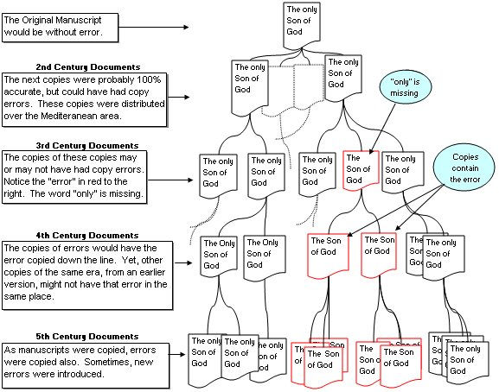
Textual tree

Slide 17
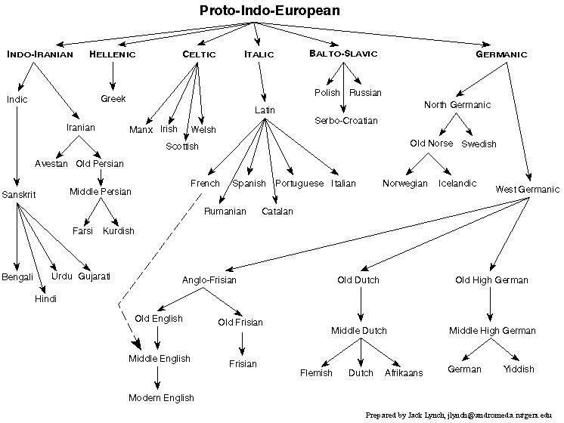
Language tree

Slide 18
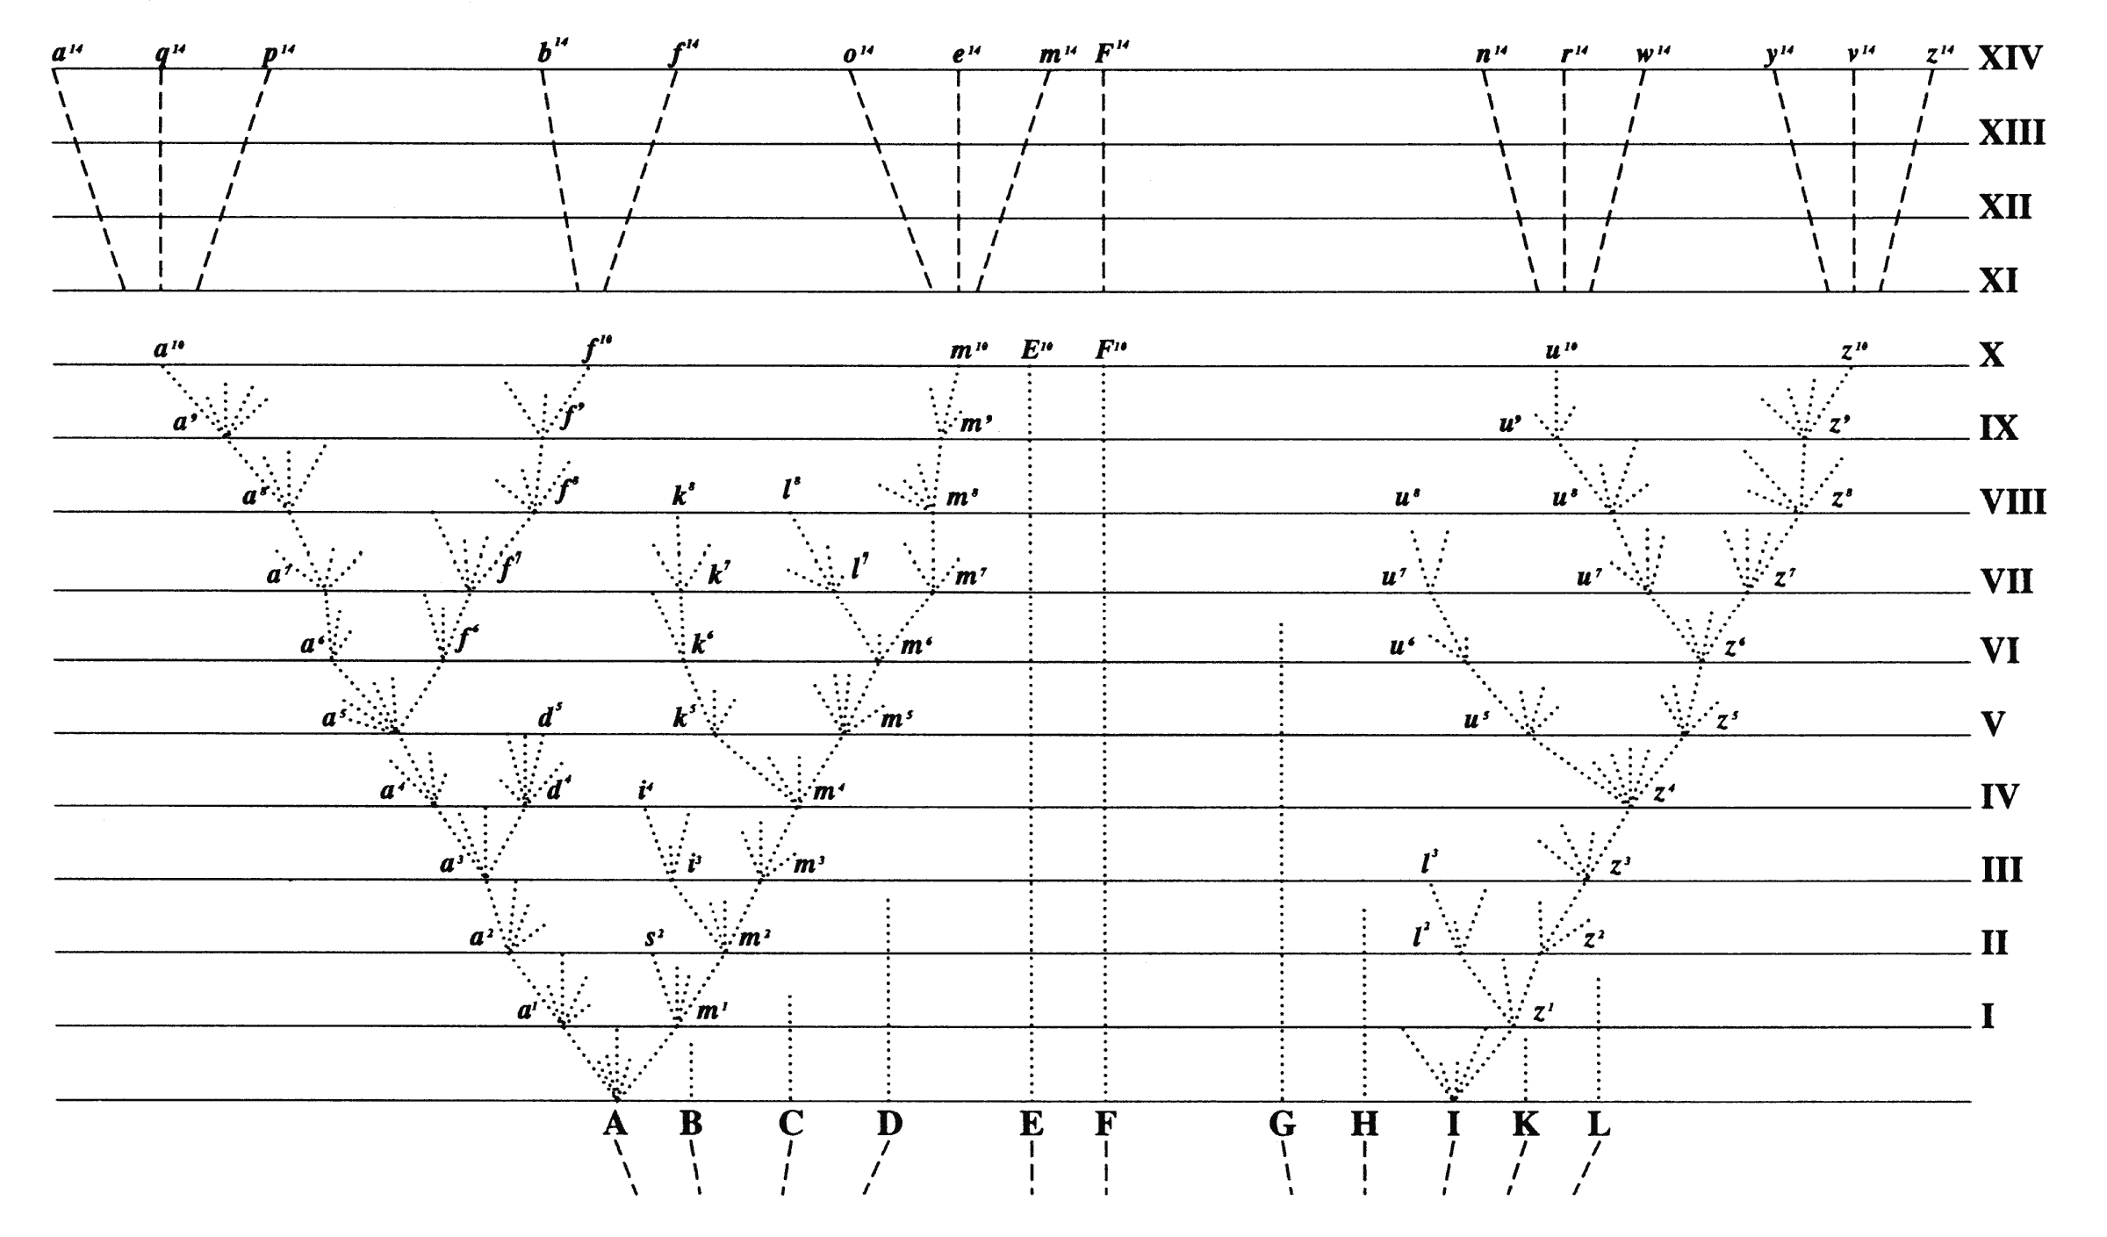
Darwin’s Tree

Slide 19
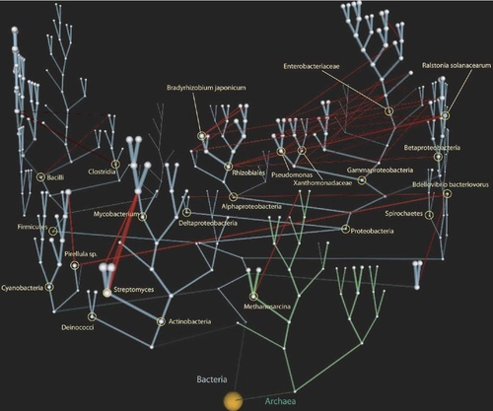
Evolutionary Bush

Slide 20
Inference of common cause Types from Types in the Social Sciences
Tokens turn into types via the averaging of causal units.
Stage 1: Comparing likelihoods of types of effects given a specific common cause type and unspecified different types of causes.

Slide 21
Creating a Gap between the likelihoods
The method is the random assignment of members to two populations to make them nearly identical in sharing the same types of (unknown or unspecified) variables with the exception of the common cause type (sometimes called the treatment) that all the members of one group share and none of the members of the other (control) group are affected by.

Slide 22
Stage II
Find the exact causal relations, which may be complex. One or more of the effect types may affect the others requiring the construction of multicollinear, interactive, and so on models

Slide 23
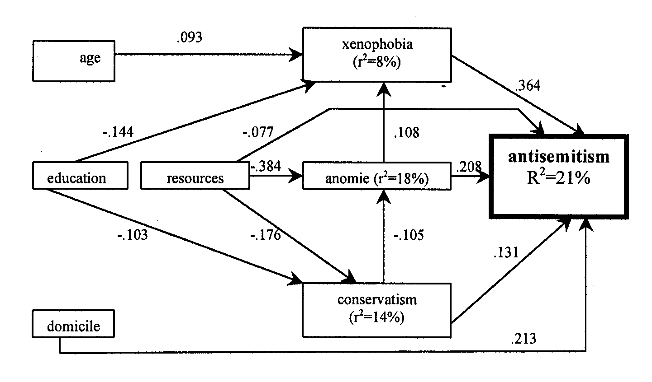
Regression Analysis as the inference of common cause types

Slide 24
Theoretical and Historical Sciecnes
Sciences of Tokens vs. Sciences of Types
Historical sciences: phylogeny, evolutionary biology, comparative historical linguistics, archaeology, cosmology, and human history.
Theoretical Sciences: physiology, physics, generative linguistics.
A distinction counter to Dilthey, Rickert, Collingwood & etc. who distinguished human History as a human or cultural or hermeneutic science.

Slide 25
Interactions between Social Science and History
Social science information theories extract nested information: e.g. economic theory of inflation.
Social science theories can affect priors of historiographic hypotheses.
But descriptions of tokens cannot refute theories of types.
Theories of types cannot deduce tokens.

Slide 26
Types to tokens underdetermined
The larger the scope, the vaguer (Marxism).
The more accurate, the narrower the scope (ad hoc historiographic interpretations).
The larger the scope, the more complex.
The larger the scope the more inconsistent (dominant power vs. balance of forces in IR).
The choice is between vagueness, narrow scope, ad hoc complexity and inconsistency.

Slide 27
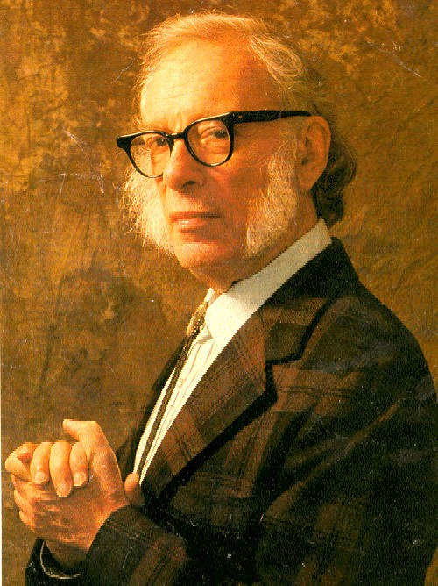
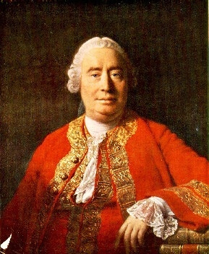
The End of History as Applied Science
Psychohistory undermined

Slide 28
Historiographic Explanation
There is no epistemic distinction between descriptive and explanatory historiographic propositions; both are the best explanations of the evidence.

